Slide 1

Computer Communications
& Networks
CSNC-2413
Week: 4
Computer Networking: A Top Down Approach
6th edition
Jim Kurose, Keith Ross
Addison-Wesley
March 2012
Packet delays, Throughput
Dr Nauman Mazhar
Faculty of Information Technology (FIT)
University of Central Punjab (UCP)

Slide 2
Chapter 1: roadmap
  1.1 what is the Internet?
  1.2 network edge
    end systems, access networks, links
  1.3 network core
    packet switching, circuit switching, network structure
  1.4 delay, loss, throughput in networks
  1.5 protocol layers, service models
  1.6 networks under attack: security
  1.7 history

Slide 3


Transmission delay
File of size L bits would take certain amount of time to be put on the link
Tx Delay:
“Time difference between when
1st bit of file is put on the link,
and when last bit is put
on the link”
File of size L bits
R: data rate of link
host
Tx Delay is determined by Data Rate of Link…
“how many bits per second the NIC can send into the line”
transmission
delay
L (bits)
R (bits/sec)
=

Slide 4
Tx delay of Packets
Application message broken into pkts of length L bits
each pkt sent into
access network at
link transmission rate
  R is link Tx rate, or
  link data rate in bps
two pkts,
L bits each
2
1
R: link transmission rate
host
packet
transmission
delay
time needed to
transmit L-bits
pkt into link
L (bits)
R (bits/sec)
=
=
Total Tx delay for 2 pkts = 2L/R secs

Slide 5
Propagation delay
bits when put on the link, take certain amount of time to travel from source to destination
bits travel with the speed of electromagnetic wave ‘s’
  s ≈ 3x10⁸ m/s
d: distance or
link length
s: propagation
speed
host
propagation
delay
d (m)
s (m/s)
=

Slide 6
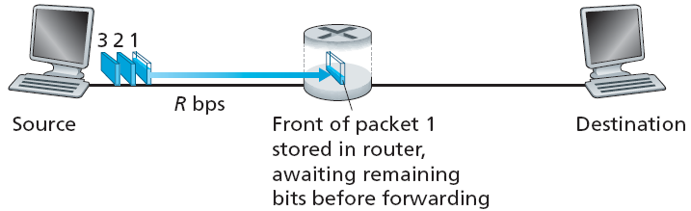
Store-and-forward (in pkt switching)
In pkt switching, routers follow Store and Forward principle
entire pkt arrives at router, then Tx on next link
End-to-end delays…
  end-to-end delay for 1 pkt… ??
  end-to-end delay for 2 pkts… ??
  end-to-end delay for 3 pkts… ??

Slide 7
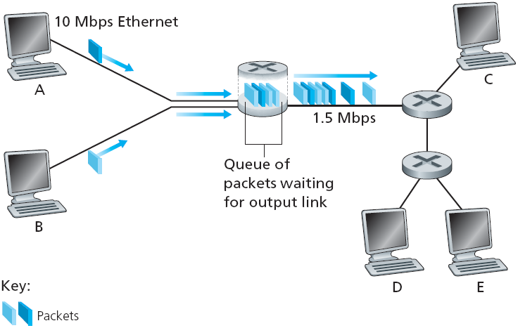
Processing & Queuing delays
Delays at Routers:
Processing delay : protocol processing (addr/error checking) takes time
Queuing delay : if pkt arrival rate at input links exceeds Tx rate of output link, pkts will be queued, waiting for Tx – Pkt delay
if router buffer fills up, pkts can be dropped – Pkt loss
  lost pkt may be re-Tx by previous node, by source, or not at all

Slide 8
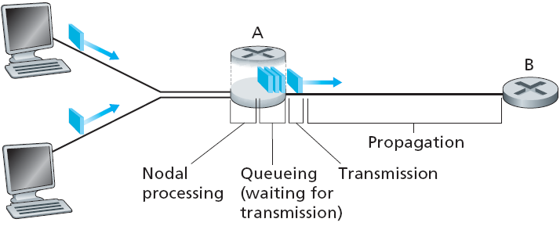
Four sources of packet delays
delay = d_{proc} + d_{queue} + d_{trans} + d_{prop}
d_{proc}: processing delay
check for bit errors
determine output link
typically < msec
d_{queue}: queueing delay
time waiting at o/p link for Tx
depends on congestion level of router

Slide 9
Four sources of packet delays
delay = d_{proc} + d_{queue} + d_{trans} + d_{prop}
d_{trans}: transmission delay
L: packet length (bits)
R: link bandwidth (bps)
d_{trans} = L/R
d_{prop}: propagation delay
d: length of physical link
s: propagation speed in medium
(~3x10⁸ m/sec)
d_{prop} = d/s

Slide 10
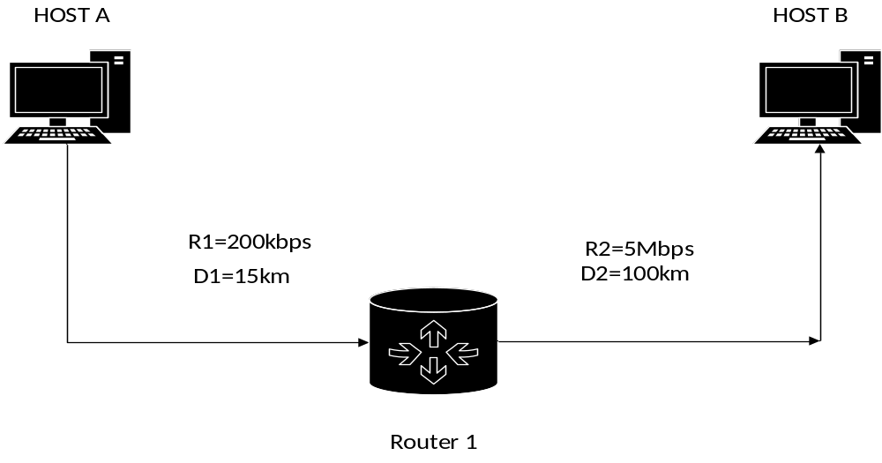
Practice Problem 1
Compute delay involved in sending 200 KB file from Host A to Host B. Propagation speed at each link is approx 3x10⁸ m/sec. Queuing delay at Router is 25 msec.

Slide 11

“Real” Internet delays & routes
What do “real” Internet delays look like...?
Traceroute program: provides delay measurement, from source to each router along the path, till the dest
For all routers…
  send three pkts to each router i on the path to dest
  router i will return the pkts to sender
  sender times the interval between Tx & reply
3 probes
3 probes
3 probes

Slide 12
“Real” Internet delays and routes
traceroute: gaia.cs.umass.edu to www.eurecom.fr
Three delay measurements from
gaia.cs.umass.edu to cs-gw.cs.umass.edu
1 cs-gw (128.119.240.254) 1 ms 1 ms 2 ms
2 border1-rt-fa5-1-0.gw.umass.edu (128.119.3.145) 1 ms 1 ms 2 ms
3 cht-vbns.gw.umass.edu (128.119.3.130) 6 ms 5 ms 5 ms
4 jn1-at1-0-0-19.wor.vbns.net (204.147.132.129) 16 ms 11 ms 13 ms
5 jn1-so7-0-0-0.wae.vbns.net (204.147.136.136) 21 ms 18 ms 18 ms
6 abilene-vbns.abilene.ucaid.edu (198.32.11.9) 22 ms 18 ms 22 ms
7 nycm-wash.abilene.ucaid.edu (198.32.8.46) 22 ms 22 ms 22 ms
8 62.40.103.253 (62.40.103.253) 104 ms 109 ms 106 ms
9 de2-1.de1.de.geant.net (62.40.96.129) 109 ms 102 ms 104 ms
10 de.fr1.fr.geant.net (62.40.96.50) 113 ms 121 ms 114 ms
11 renater-gw.fr1.fr.geant.net (62.40.103.54) 112 ms 114 ms 112 ms
12 nio-n2.cssi.renater.fr (193.51.206.13) 111 ms 114 ms 116 ms
13 nice.cssi.renater.fr (195.220.98.102) 123 ms 125 ms 124 ms
14 r3t2-nice.cssi.renater.fr (195.220.98.110) 126 ms 126 ms 124 ms
15 eurecom-valbonne.r3t2.ft.net (193.48.50.54) 135 ms 128 ms 133 ms
16 194.214.211.25 (194.214.211.25) 126 ms 128 ms 126 ms
17 * * *
18 * * *
19 fantasia.eurecom.fr (193.55.113.142) 132 ms 128 ms 136 ms
trans-oceanic
link
means no response (probe lost, router not replying)

Slide 13
Throughput
Throughput : data rate achieved, when bits are transferred between sender & receiver (bits/sec)
  Instantaneous : at any given point in time
  Average : over a longer period of time
Consider that a file takes certain amount of time (delay) to be transferred from Host A to host B
Average thruput, i.e, data rate achieved, would be…
Avg Thruput (bps) = File size / delay

Slide 14

Thruput vs Bottleneck Link
Consider a Server with file of F bits to send to a Client…
bottleneck link
slowest link on end-end path, that limits the average thruput
If R_{s} > R_{c} What is average end-end thruput?
R_{s} bits/sec
R_{c} bits/sec
If R_{s} < R_{c} What is average end-end thruput?
R_{s} bits/sec
R_{c} bits/sec

Slide 15
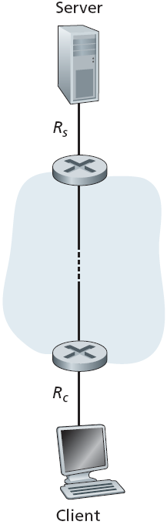
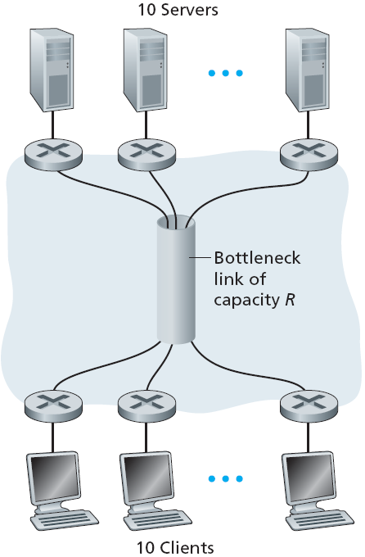
Thruput: Internet scenario
If 10 connections share some backbone link of R bits/sec
per-connection end-end thruput:
min (R_{c} R_{s} R/10)
in practice: R_{c} or R_{s} is often the bottleneck

Slide 16
Practice Problem 2
Suppose Host A wants to send a large file to Host B. Path from Host A to Host B has three links of data rates R1 = 500 kbps,
R2 = 2 Mbps, & R3 = 4 Mbps, connected thru two intermediate routers.
  Assuming no other traffic in the network, what average throughput would be achieved for the file transfer
  If link lengths are 100 m, 200 kms, and 10 km, how long does it take for pkt of length 1,000 bytes to reach from Host A to Host B. Consider propagation speed as 2.5 x 10⁸ m/s
  If file is 4 million bytes, how long does it take to transfer the file to Host B, when pkt size is 1 KB and all pkts are sent back to back; consider 50 ms queuing delay & 20 ms proc delay at each router
  What is the thruput achieved for file transfer in part (c)

Slide 17
(a) Assuming no other traffic in the network, what average throughput would be achieved for the file transfer
Host A
Host B
R1 = 500 kbps
R2 = 2 Mbps
R3 = 4 Mbps
Thruput achieved will depend on the bottleneck link…
Which is the bottleneck link here… R1
So, the average thruput achieved would be 500 kbps

Slide 18
(b) If link lengths are 100 m, 200 kms, and 10 km, how long does it take for pkt of length 1,000 bytes to reach from Host A to Host B. Consider propagation speed as 2.5 x 10⁸ m/s
d1 = 100 m
d2 = 200 kms
d3 = 10 km
Host A
1
2
Host B
R1 = 500 kbps
R2 = 2 Mbps
R3 = 4 Mbps
Pkt size L = 1 KB
What all trans delays will be there…
  Trans delay from Host A to Link 1 = L/R1 = 1 KB/500 kbps = 16 ms
  Trans delay from Router 1 to Link 2 = L/R2 = 1 KB/2 Mbps = 4 ms
  Trans delay from Router 2 to Link 3 = L/R3 = 1 KB/4 Mbps = 2 ms
Total Trans delay = L/R1 + L/R2 + L/R3 = L (1/R1 + 1/R2 + 1/R3) = 22 ms

Slide 19
(b) If link lengths are 100 m, 200 kms, and 10 km, how long does it take for pkt of length 1,000 bytes to reach from Host A to Host B. Consider propagation speed as 2.5 x 10⁸ m/s
d1 = 100 m
d2 = 200 kms
d3 = 10 km
Host A
1
2
Host B
R1 = 500 kbps
R2 = 2 Mbps
R3 = 4 Mbps
What all Prop delays will be there…
  Prop delay from Host A to Router 1 = d1/s = 100 m/ 2.5 x 10⁸ m/s
  Prop delay from Router 1 to Router 2 = d2/s = 200 km/ 2.5 x 10⁸ m/s
  Prop delay from Router 2 to Host B = d3/s = 10 km/ 2.5 x 10⁸ m/s
Total Prop delay = d1/s + d2/s + d3/s = (d1+d2+d3)/s = 0.8404 ms
Total file transfer delay = Total Trans delay + Total Prop delay = 22.8404 ms

Slide 20
(c) If file is 4 million bytes, how long does it take to transfer the file to Host B, when pkt size is 1 KB and all pkts are sent back to back; consider
50 ms queuing delay & 20 ms proc delay at each router
50 + 20 ms
50 + 20 ms
Host A
1
2
Host B
R1 = 500 kbps
R2 = 2 Mbps
R3 = 4 Mbps
d1 = 100 m
d2 = 200 kms
d3 = 10 km
Number of pkts to send 4 MB file = 4 MB/ 1 KB = 4000
First find total Trans delay at Host A for 3999 pkts…
  Trans delay for I pkt = L/R1 = 1 KB/500 kbps = .016 s = 16 ms
  Trans delay for 3999 pkts = 3999 L/R1 = 63.984 s
Then find total delay for last pkt, from Host A to Host B = 162.8404 ms
Also add queuing & proc delays at each router… 2 (50 + 20) ms
Finally, add 3999 L/R1 to the total delay computed above…

Slide 21
  (d) What is the thruput achieved for file transfer in part (c)
50 + 20 ms
50 + 20 ms
Host A
1
2
Host B
R1 = 500 kbps
R2 = 2 Mbps
R3 = 4 Mbps
d1 = 100 m
d2 = 200 kms
d3 = 10 km
Thruput = total data transferred / total time taken = 498.8554 kbps
  File size = 4 MB
  Total time taken = delay computed in (c)

Slide 22
Summary: chap 1
  1.1 what is the Internet?
  1.2 network edge
    end systems, access networks, links
  1.3 network core
    packet switching, circuit switching, network structure
  1.4 delay, loss, throughput in networks
  1.5 protocol layers, service models
  1.6 networks under attack: security
  1.7 history

